Slide 2

U.S. Department of Justice
Day Two
Post
Award
Activities

Slide 3


U.S. Department of Justice
Nuts & Bolts
From Day One

Slide 4
U.S. Department of Justice
Memorable Moments-Day One
Financial Management System must meet the requirements for receipt, obligation and expenditure of all grant funds
  Federal cost share & local cost share (match)
    Calculate correctly
    All subject to the same rules
  Planning & property control and periodic reporting
Internal controls
Segregation of duties

Slide 5
U.S. Department of Justice
Memorable Moments-Day One
Internal agency policies, procedures
  Procurement, personnel, travel, accounting, etc.
  Current email, username, passwords, schedule password/log changes and SAM updates
Supplementing-Good/Supplanting-BAD!
Approved budget categories & items
Prior approval Items
  Consultant rate ($650) prior approval threshold
  Sole source (non-competitive ^ $250K)
  DOCUMENTATION

Slide 6
U.S. Department of Justice
Memorable Moments-Day One
External rules of the game –
  Order of precedence
  Be sure you follow the guidance for the particular grant, program, and agency awarding the grant
  DOJ Grants Financial Guide – “Current Edition” is 2024
  Budget details & “Flexibility”

Slide 7
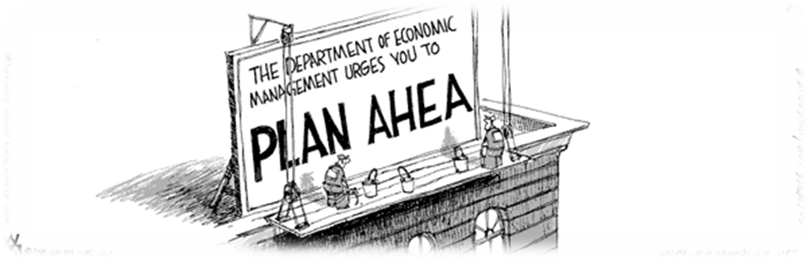
U.S. Department of Justice
“Prediction is very difficult,
especially if it's about the future.”
-Yogi Berra

Slide 8

U.S. Department of Justice
Evaluation & Sign In

Slide 9
Post Award Activities

Slide 10

Award Notification
and Acceptance

Slide 11

Award Notification and Acceptance
Award notifications are issued electronically in Just Grants
An email notification will be sent to the Application Submitter, the Authorized Representative(s), and the Entity Administrator with detailed instructions on how to access and accept the award in Just Grants.

Slide 12



Award Notification and Acceptance
Prior to accepting the award the Recipient/Entity Administrator should:
Make sure they have set up their Just Grants account and are enrolled in the Automated Standard Application for Payments (ASAP)
Assign a Financial Manager, a Grant Award Administrator, and an Authorized Representative to the award
*The Authorized Representative has the legal authority to enter into contracts, grants, and cooperative agreements with the federal government on behalf of the Entity.

Slide 13


Award Notification and Acceptance
To accept the award, the Authorized Representative should:
Read each section of the award package and certify that they have read and understood the information.
Review all award conditions. Check each section’s checkbox indicating they have read and understood all information presented in that section.
Once all acceptance boxes in each section have been checked and the Declaration and Certification has been checked, they can choose to Accept or Decline the Award.

Slide 14
Conditions of Award

Slide 15

Conditions of Award
The recipient agrees to comply with the requirements set forth in 2 CFR Part 200 Uniform Administrative Requirements, Cost Principles, and Audit Requirements for Federal Awards.

Slide 16

Conditions of Award
The recipient agrees to comply with the financial and administrative requirements set forth in the current edition of the “DOJ Grants Financial Guide."

Slide 17
Conditions of Award
Comply with the training requirement for the Grant Award Administrator and all Financial Managers to successfully complete an OJP financial management and grant administrative training by 120 days after the date the recipient accepts the award.

Slide 18
Conditions of Award
A recipient that is eligible to use the “de minimis” indirect cost rate and elects to use the “de minimis” indirect cost rate, must advise OJP in writing of both its eligibility and its election and must comply with all associated requirements in the Part 200 Uniform Requirements.

Slide 19
Conditions of Award
All subawards (“subgrants”) at any tier, must have specific federal authorization.

Slide 20
Conditions of Award
Recipients and any subrecipients at any tier, must obtain specific post-award approval to use a noncompetitive approach in any procurement contract that would exceed the Simplified Acquisition Threshold (currently $250,000).

Slide 21
Conditions of Award
The recipient agrees that DOJ may withhold award funds or impose other requirements if the recipients does not promptly address outstanding issues related to an audit.

Slide 22
Availability of Funds

Slide 23

Availability of Funds
Obligation Period (Grantee’s books)
  EX: 10/1/2023 - 09/30/2026
Award date = 12/1/2023 (Federal books)
Expenditure Period
  EX: 10/1/2023 - 01/28/2027
Liquidation Period (120 days after end of award)
  Ex: 10/01/2023 - 01/28/2027
Funds will be frozen 120 days after the end of the award.

Slide 24
Availability of Funds
Pre-agreement Costs
Costs incurred prior to the project start date
Written prior approval

Slide 25
Program Income

Slide 26

Program Income
Gross income earned by the recipient or subrecipient during the funding period as a direct result of a supported activity or earned as a result of the Federal award.

Slide 27
Program Income
Spend prior to requesting additional grant funds
Supplement Project with $$
Reduce Project with $$
Send Back $$

Slide 28
Payment of Grant Funds

Slide 29
Payment of Grant Funds
For the ASAP slides-
Please refer to the zip file you received by email.

Slide 30
Grant Award Modification (GAM)

Slide 31

Grant Award Modification
The purpose of a Grant Award Modification (GAM) is to update/modify key facts or details about the award.
There are three types of award changes that can be performed in the GAM system:
  Financial;
  Project Period Extension; and
  Programmatic.

Slide 32
Grant Award Modification
Financial GAMs have four subtypes:
  Budget Modification;
  Budget Reduction;
  Sole Source Approval; and
  Budget Clearance (Financial Grants Management Initiator only).
Project Period Extension GAM is used to extend the length of the funded award.
Programmatic GAMs have two subtypes:
  Programmatic Costs; and
  Scope Change.

Slide 33


BREAK TIME

Slide 34

15 Minutes
Notes:
34
34
Using this PowerPoint break timer
This PowerPoint slide uses images, custom animation, and timing to provide a countdown timer that you can use in any presentation. When you open the template, you’ll notice that the timer is set at 00:00. However, when you start the slide show, the timer will start at the correct time and count down by 1-minute intervals until it gets to 1 minute. At that point, it will count down in two 30-seconds intervals to 00:00.
To insert this slide into your presentation
Save this template as a presentation (.ppt file) on your computer.
Open the presentation that will contain the timer.
On the Slides tab, place your insertion point after the slide that will precede the timer. (Make sure you don't select a slide. Your insertion point should be between the slides.)
On the Insert menu, click Slides from Files.
In the Slide Finder dialog box, click the Find Presentation tab.
Click Browse, locate and select the timer presentation, and then click Open.
In the Slides from Files dialog box, select the timer slide.
Select the Keep source formatting check box. If you do not select this check box, the copied slide will inherit the design of the slide that precedes it in the presentation.
Click Insert.
Click Close.

Slide 35
Reporting Requirements

Slide 36
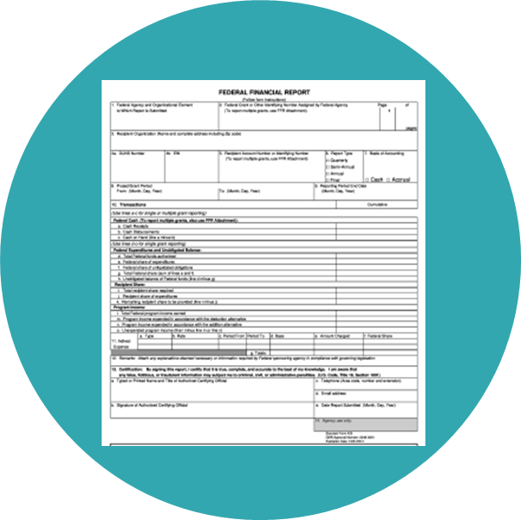


Reporting Requirements
Federal Financial Report (SF–425)
Submitted Quarterly
Performance Reports – Programmatic Reports Submitted Annually, Semi-annually or Quarterly

Slide 37

Federal Financial Reports (SF425)

Slide 38
Federal Financial Reports (SF425)
Quarterly Federal Financial Reports are submitted through the Just Grants system at https://justicegrants.usdoj.gov
Grant recipients will be required to report grant expenditures utilizing the web based Federal Financial Report Form (SF-425) in Just Grants.
The SF-425 quarterly report may be submitted ten (10) calendar days or less from a reporting end date until the due date.

Slide 39
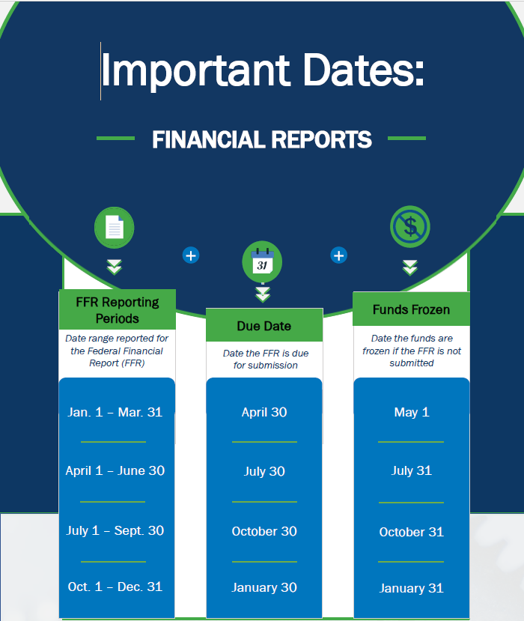
Federal Financial Reports (SF425)

Slide 40
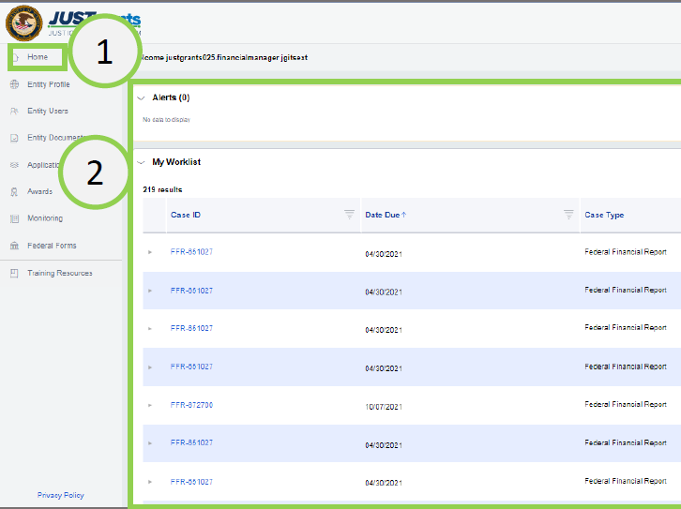
Submitting a Federal Financial Report (SF425)
Navigate to the Home link on the left side of the screen.
Go to the user’s Worklist.
Open the FFR to be edited/submitted.

Slide 41
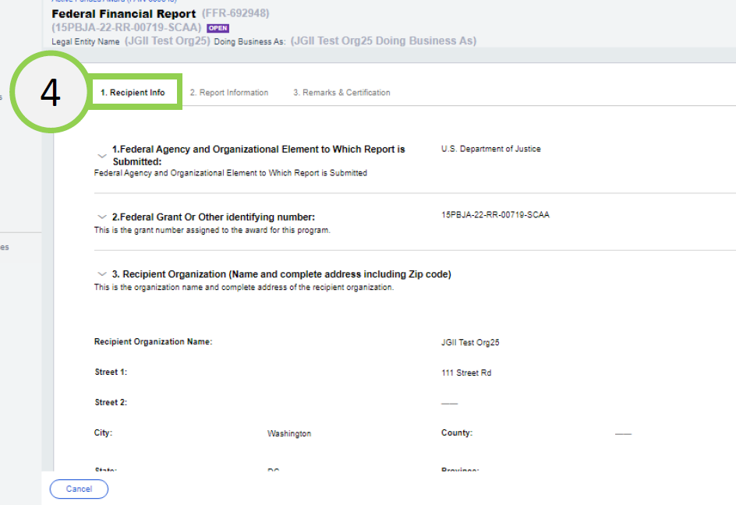
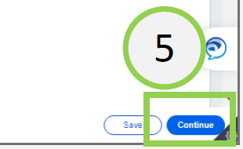
Submitting a Federal Financial Report (SF425)
4) Once the FFR opens, the Recipient Information appears.
5) Select Continue to proceed to the next screen
* Note: The data on this page is prepopulated using information from the award document and the entity profile.

Slide 42
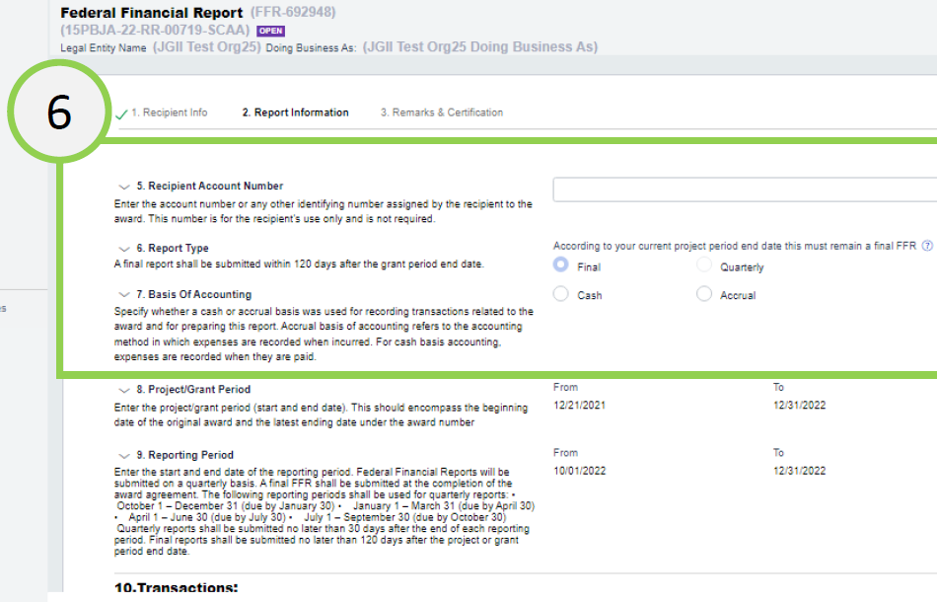
Submitting a Federal Financial Report (SF425)
6) The Report Information screen contains several required fields.
Recipient Account Number
Report Type
Basis of Accounting
7) Scroll down to the Transactions section.

Slide 43
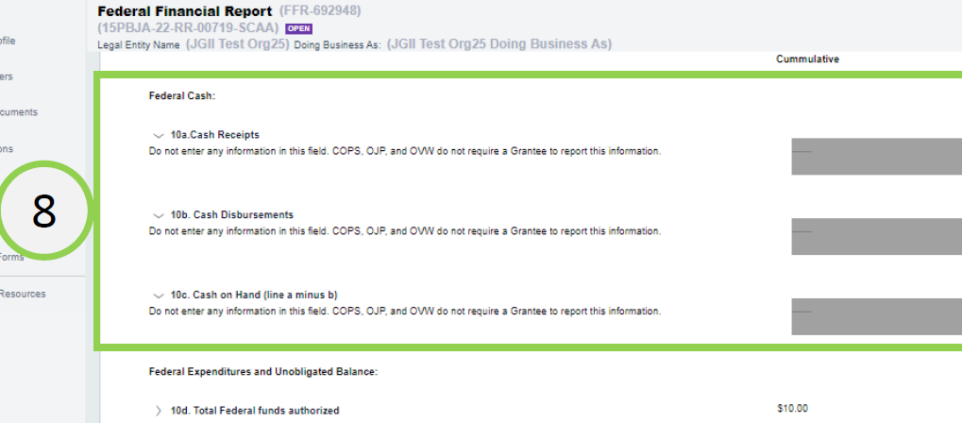
Submitting a Federal Financial Report (SF425)
8) The following fields are not editable because they are not required by DOJ:
10a. Cash Receipts
10b. Cash Disbursements
10c. Cash on Hand

Slide 44
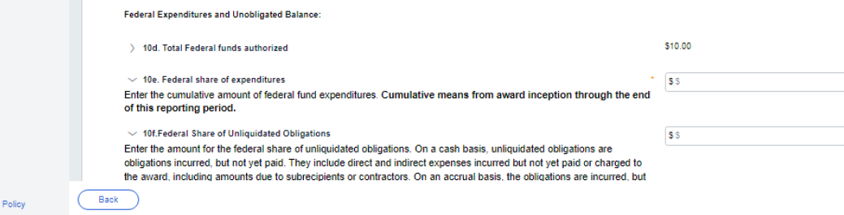
Submitting a Federal Financial Report (SF425)
9
9) Enter information in the following fields as appropriate:
10d. Total Federal funds authorized. (Prepopulated from the Award Document)
10e. Federal share of expenditures. (Enter the cumulative amount of federal fund expenditures)
10f. Federal Share of Unliquidated Obligation. (Insert as appropriate)

Slide 45
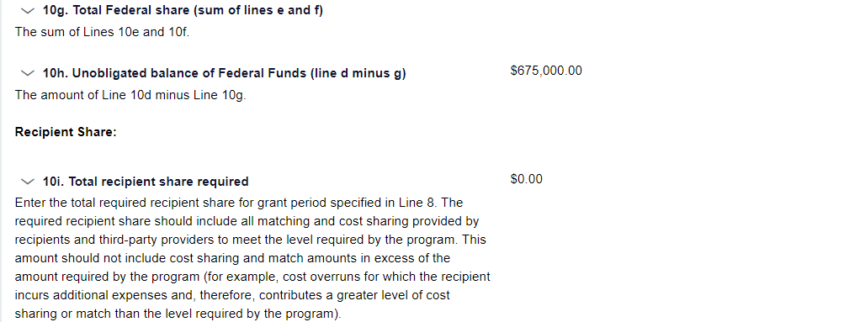
Submitting a Federal Financial Report (SF425)
9
9) Enter information in the following fields as appropriate:
10g. Total Federal share (sum of lines e and f; System calculated)
10h. Unobligated balance of Federal Funds (line d minus g)
10i. Total recipient share required.

Slide 46
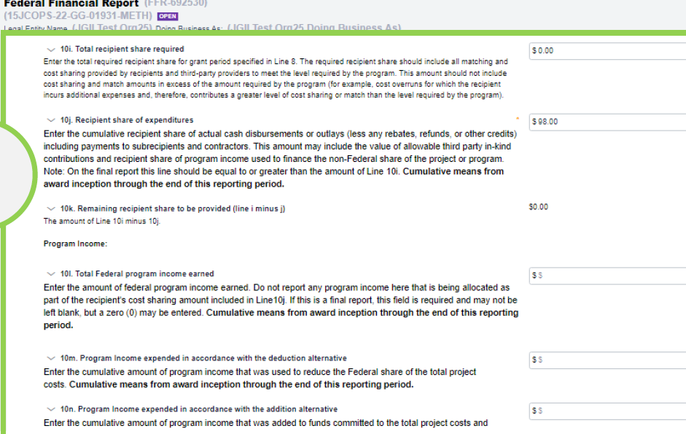

Submitting a Federal Financial Report (SF425)
10) Enter information in the following fields as appropriate:
10j. Recipient share of expenditures
10k.Remaining recipient share to be provided (line i minus j)
10l. Total Federal program income earned
10m. Program income expended in accordance with the deduction method
10n. Program income expended in accordance with the addition method
10o. Unexpended program income
* Note: OJP uses the deduction method
10

Slide 47
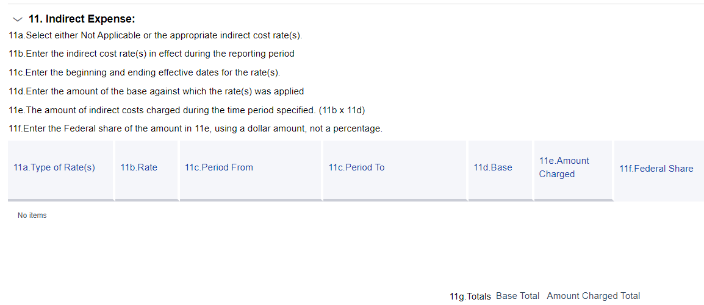
Submitting a Federal Financial Report (SF425)
11) Enter Indirect Expenses. Depending on the Type of Rate, the
user will be presented with different fields to complete.
* Note: Indirect expenses are NOT cumulative. Indirect expenses are entered with a Start Date and End Date, and the totals are applied based on those dates, rather than the Project Period Start Date and Project Period End Date, as are all other expenses.

Slide 48
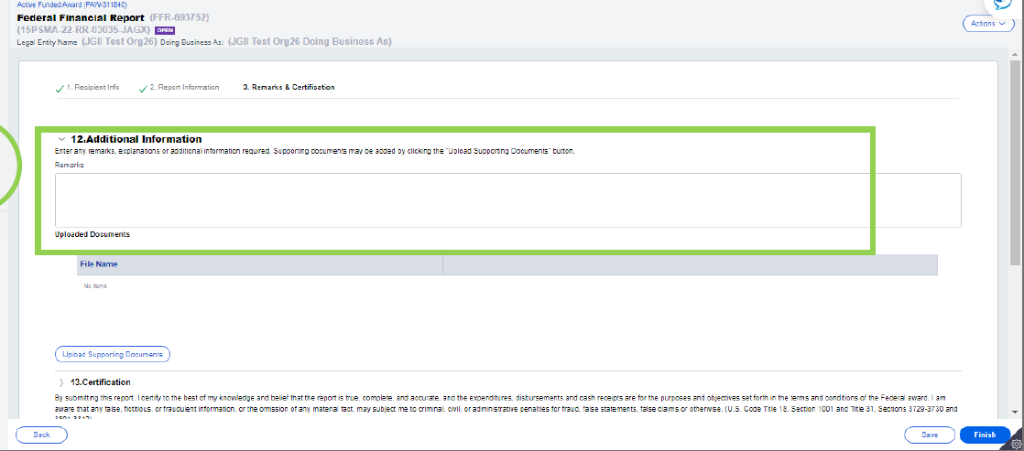
Submitting a Federal Financial Report (SF425)
12) In the Remarks and Certification screen, enter text in box 12: Additional Information,
any remarks, explanations or additional information required. Supporting documents may be added by clicking the “Upload Supporting Documents” button.
Remarks

Slide 49
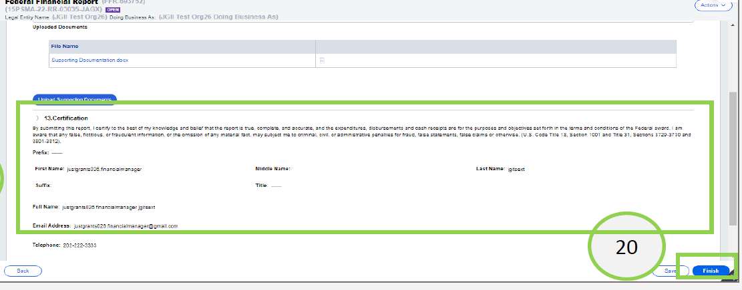
Submitting a Federal Financial Report (SF425)
13) Review the certification section then select the Finish button.

Slide 50

Editing a Federal Financial Report (SF425)
The Financial Manager can edit a submitted FFR only if it is the most recently submitted FFR and the next FFR has not been generated.
Example A: It is February 26, 2023, and the Financial Manager wants to edit the FFR which includes information from 10/1/22-12/31/22 reporting period.
FFR-1
FFR-2
FFR-3
Reporting Period:
7/1/22 to 9/30/22
Due Date of Report:
10/30/22 (previous FFR)
Reporting Period:
10/1/22 to 12/31/22
Due Date of Report:
1/30/23 (direct previous FFR)
Reporting Period:
1/21/23 to 3/31/23
Due Date of Report:
4/30/23 (current FFR)
The Financial Manager can edit and resubmit FFR-2 because it is:
The directly previous FFR, AND
The next FFR has not been generated.
FFR-2 can be edited until March 31,2023, the final day of the next reporting period, when the next report is generated.

Slide 51
Editing a Federal Financial Report (SF425)
The Financial Manager can edit a submitted FFR only if it is the most recently submitted FFR and the next FFR has not been generated.
Example B: It is April 1, 2023, and the Financial Manager wants to edit the FFR which includes information from 10/1/22-12/31/22 reporting period.
FFR-1
FFR-2
FFR-3
FFR-4
Reporting Period:
7/1/22 to 9/30/22
Due Date of Report:
10/30/22 (previous FFR)
Reporting Period:
10/1/22 to 12/31/22
Due Date of Report:
1/30/23 (direct previous FFR)
Reporting Period:
1/21/23 to 3/31/23
Due Date of Report:
4/30/23 (current FFR)
Reporting Period:
4/1/23 to 6/30/23
Due Date of Report:
7/30/23 (current FFR)
The Financial Manager will not be able to reopen and edit FFR-2 because FFR-4 has already been generated. The Financial Manager will be able to reopen and edit FFR-3 until June 30 since that is the most recently submitted FFR.

Slide 52
Federal Financial Reports (SF425)
FFR Helpful Tips
Report actual expenditures not disbursements from Federal Government.
Report correct indirect cost type, rate, and base.
Financial Manager can revise submitted reports prior to the due date.
Funds will be frozen in ASAP if the FFR is delinquent.
The Final FFR is due 120 days after the end of the grant period.

Slide 53
Performance Reports
Performance Reports
Performance Reports, formerly called Progress reports are submitted in Just Grants
Describes the status of a project and its accomplishments.
Report requirements are determined by the program/program office.
Check the special conditions on your Award Document or the Solicitation, to determine due dates for Performance Reports.

Slide 54
Performance Reports
Performance Reports are reviewed and approved by the OJP program manager
If the Performance Report is delinquent, grants funds will be frozen.
The Final Performance Report is due 120 days after the end of the grant period.

Slide 55

U.S. Department of Justice
FFR Exercise

Slide 56
2 CFR Part 200/Subpart F
Audit of Non-Federal Entities
Expending Federal Awards

Slide 57
Audit Requirements
2 CFR
Subpart F applicable
to all
non-federal entities
Thresholds $1 million
or more expended during
the FY –
Single Audit required
Audit Report due nine (9) months after end of FY
Submit
online to Federal Audit Clearinghouse
(FAC)
$25,000
or more in questioned costs must
be included
in the Single
Audit report
Due
9 Months after end
of FY
Submit online to FAC
$25K
Questioned Costs
2 CFR Subpart F
$1 million
Thresholds
Notes:
2 CFR Subpart F applicable to all non-federal entities
Thresholds $1 million or more expended during the FY - Single Audit required
Audit Report - due nine (9) months after end of FY
Submit online to Federal Audit Clearinghouse (FAC)
$25,000 or more in questioned costs must be included in the Single Audit report

Slide 58
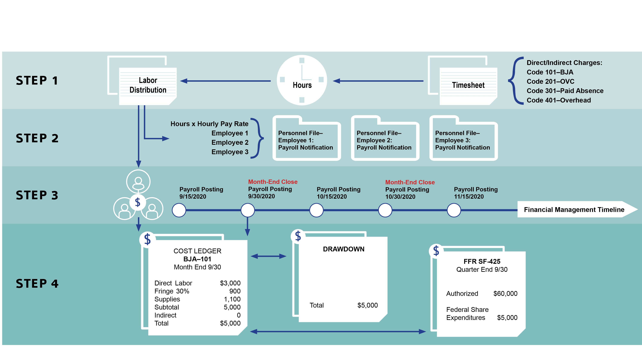
Audit Trail

Slide 59



Single Audit
Federal Audit Clearinghouse (FAC) Requirement
  All grant recipients to submit online via Internet Data Entry System (IDES):
form
SF SAC
Single Audit Report package
IF AUDIT REPORT IS DELINQUENT, FUNDS MAY BE WITHHELD.

Slide 60



Resolution of Audit Reports
Office of Audit, Assessment, and Management
Establish working file for the audit report.
Review and analyze the audit report.
If there are any findings, a letter must be generated to the audited recipient. This letter should include a request for a Corrective Action Plan (CAP).

Slide 61
Resolution of Audit Reports
The corrective action plan (CAP) should include:
Description of each finding.
Specific steps to implement the recommendation.
Timetable for performance of each corrective action.
Description of monitoring to be performed.

Slide 62

Top 10 Auditing Findings (FY 2024)
1
Procedures not documented or need improvement.
2
Questioned costs – unsupported/unallowable.
3
Subgrantee monitoring not being conducted.
4
Financial and Program Reports not accurately prepared.
5
Special Conditions not met by grantee.

Slide 63
Top 10 Auditing Findings (FY 2024)
6
Financial and/or Program Reports inaccurate, and/or not submitted timely.
7
Drawdowns not adequately supported and/or Excess cash-on-hand identified.
Suspension and Debarment - verification not performed or not properly documented.
8
9
Indirect Costs charged improperly
10
Accounting system inadequate or not effectively utilized.

Slide 64
Federal Funding Accountability and Transparency Act of 2006 (FFATA)

Slide 65

FFATA - Subaward and Executive Compensation
Requires prime recipients to report on first-tier subawards of $30K or more.
  Requires prime recipients to report executive compensation for prime or subawards if:
The organization received 80% or more of its annual gross revenues in Federal awards and those revenues are greater than $25 million; and
The public does not have access to information about executive compensation through periodic reporting.

Slide 66


FFATA - Subaward and Executive Compensation
When to Report
For Federal awards of $30K or more the prime recipient must report first-tier and executive compensation data.
Data must be reported in FSRS the following month after the obligation is made.
Example: Awards made during October will have until November 30th to report.

Slide 67

FFATA - Subaward and Executive Compensation
Prime recipients must report FFATA requirements in the (FFATA) Subaward Reporting System (FSRS) https://www.fsrs.gov/.

Slide 68
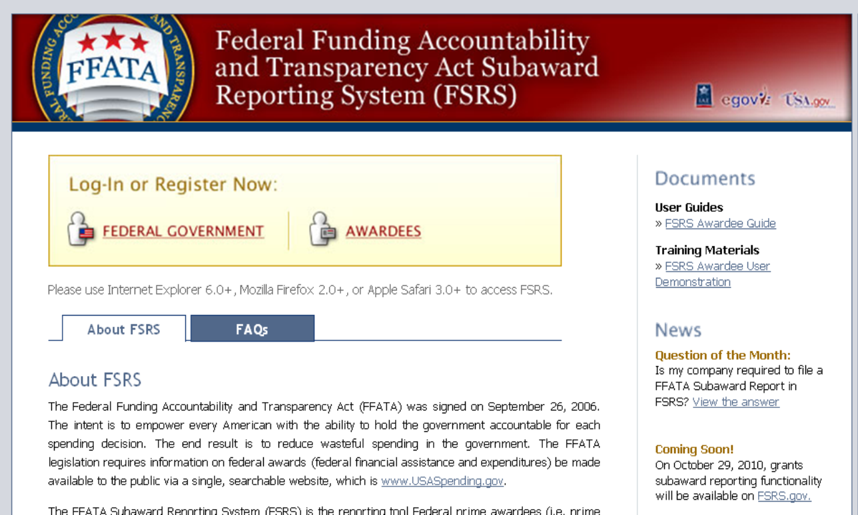
FSRS.GOV
FSRS –Federal Funding Reporting System

Slide 69
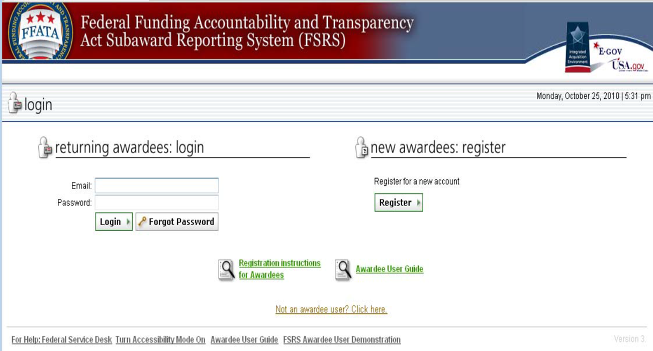
FSRS –Federal Funding Reporting System

Slide 70
FSRS – Federal Funding Reporting System
Awardee Registration Screen

Slide 71

FSRS – Federal Funding Reporting System

Slide 72
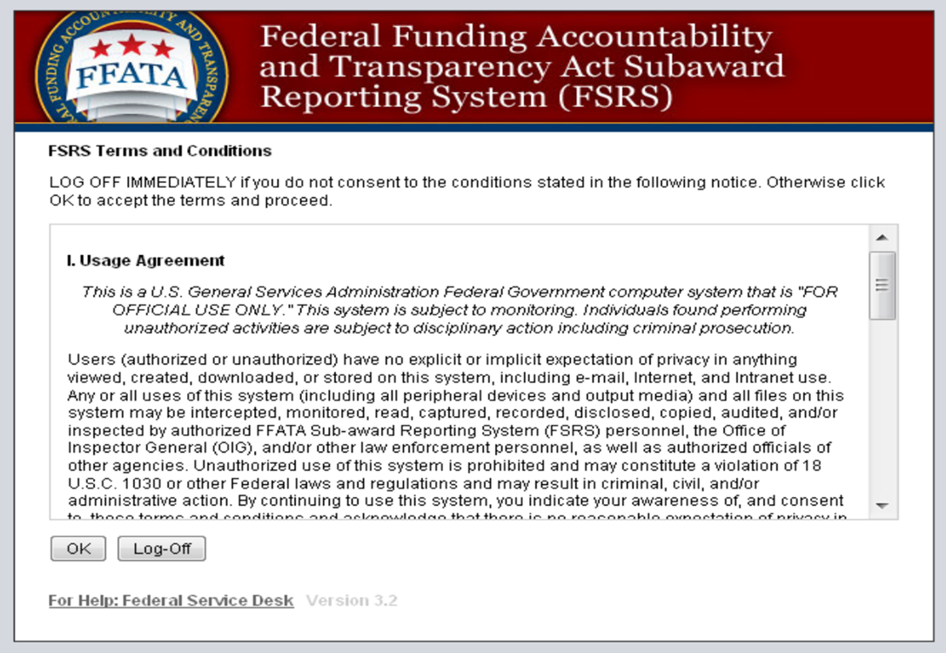
FSRS – Federal Funding Reporting System

Slide 73
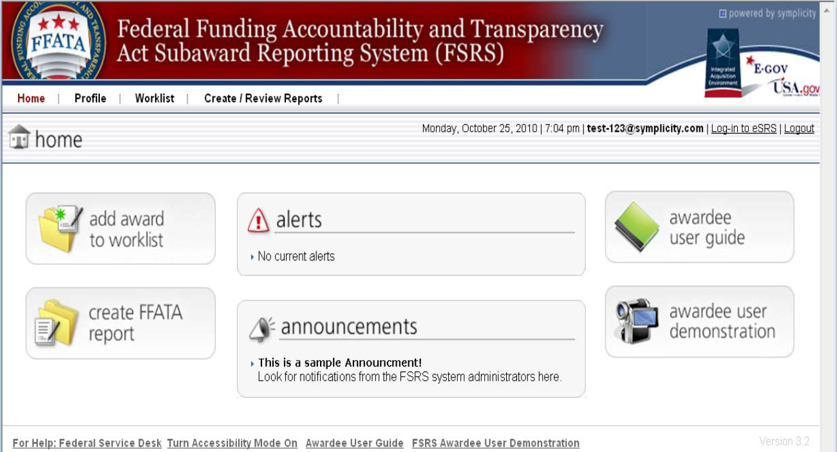
FSRS – Federal Funding Reporting System

Slide 74
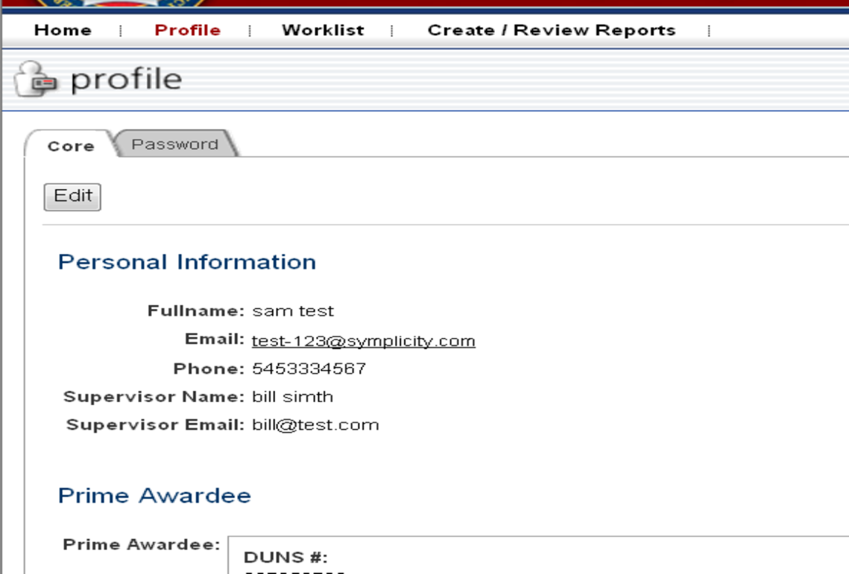
FSRS – Federal Funding Reporting System

Slide 75
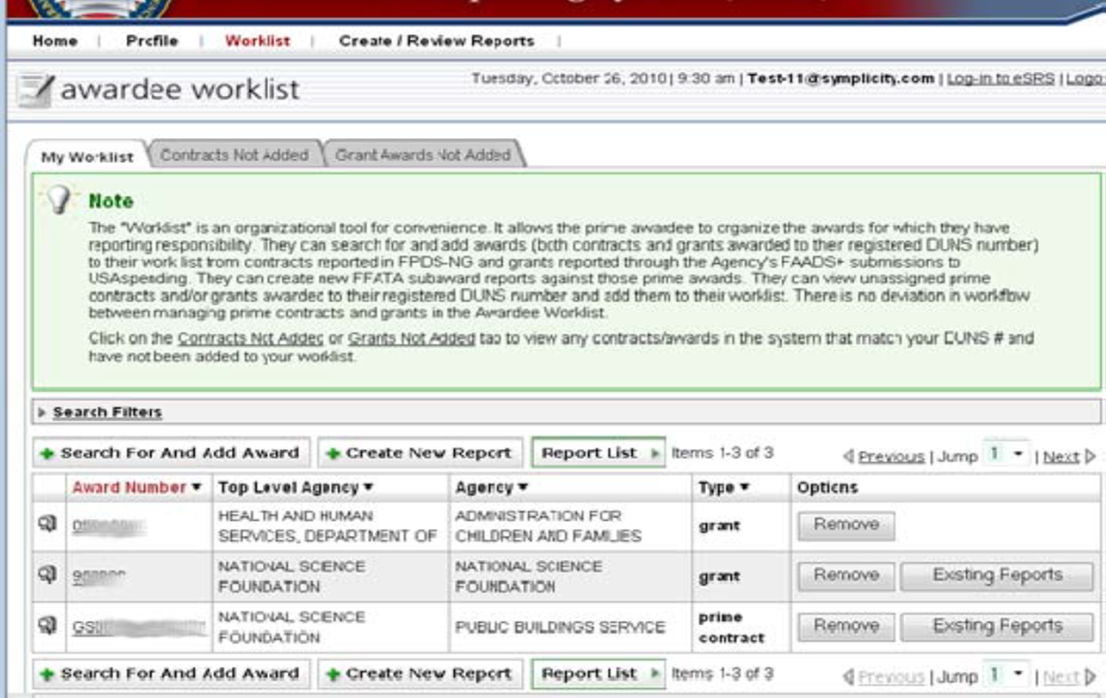
FSRS – Federal Funding Reporting System

Slide 76
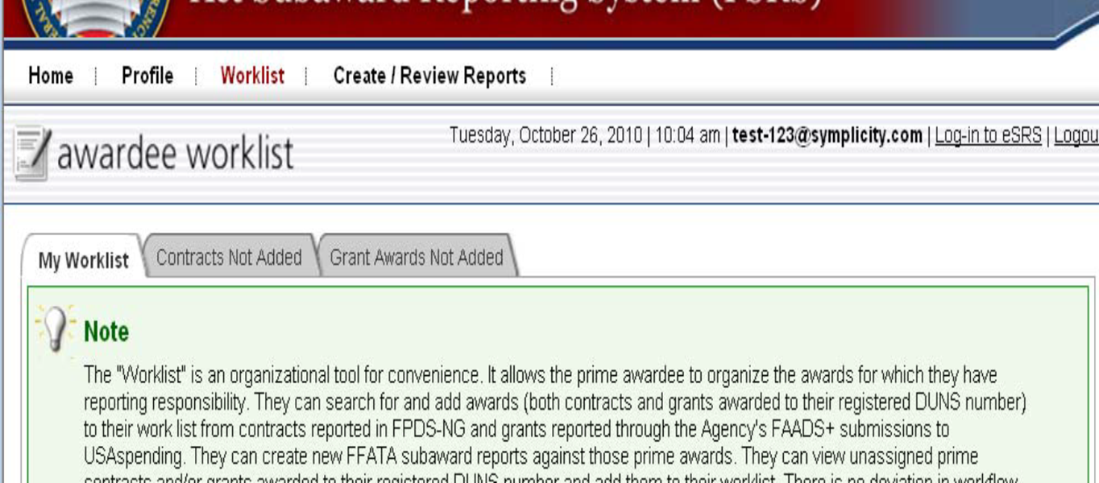

FSRS – Federal Funding Reporting System

Slide 77
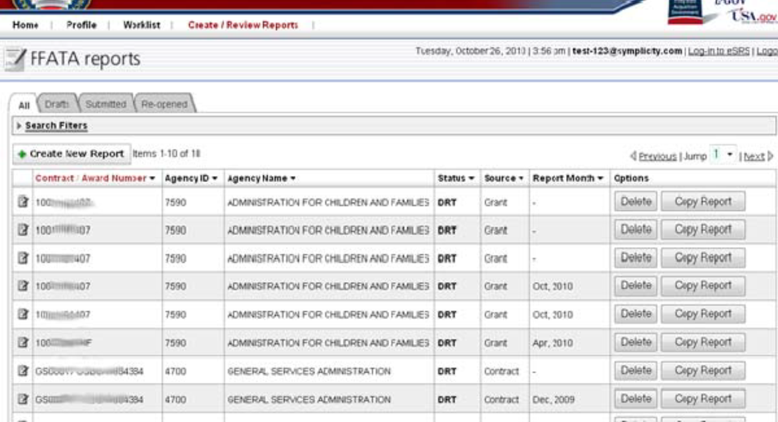



FSRS – Federal Funding Reporting System

Slide 78
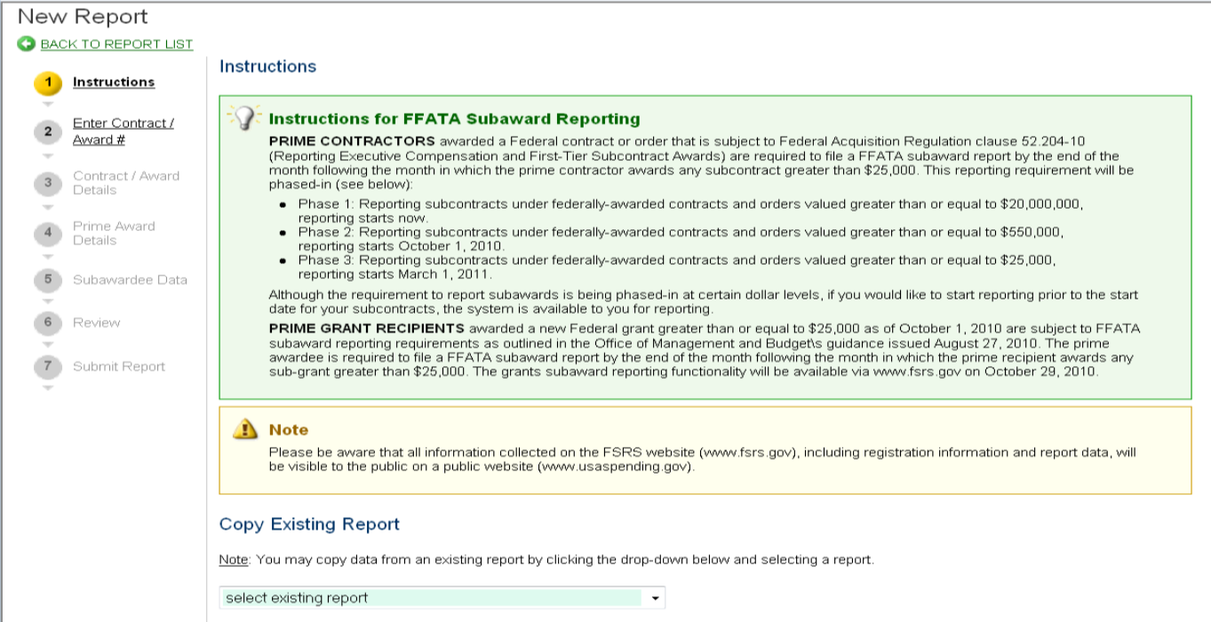

FSRS – Federal Funding Reporting System

Slide 79
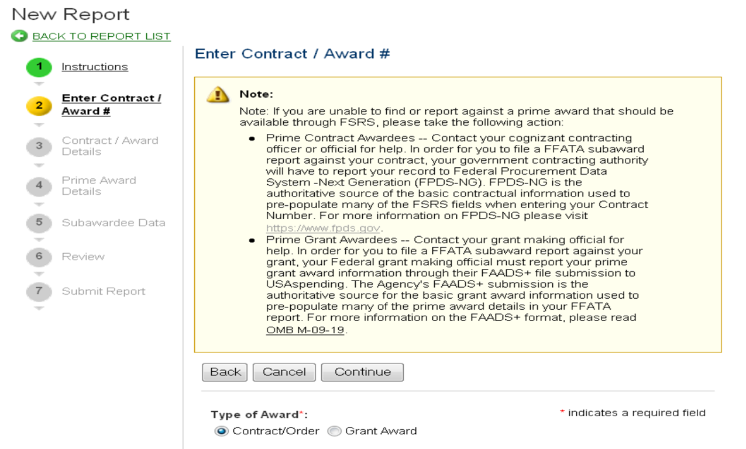

FSRS – Federal Funding Reporting System

Slide 80
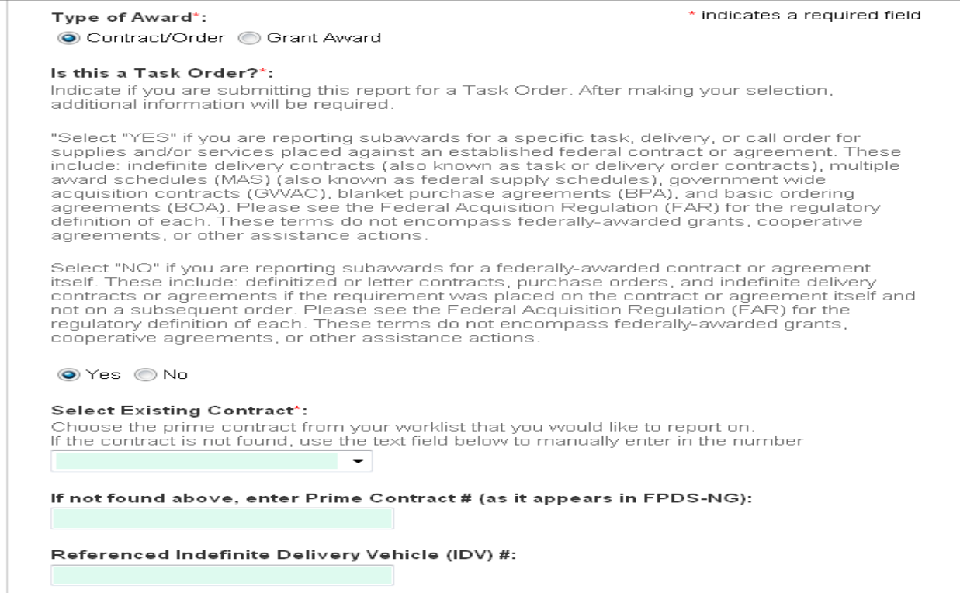
FSRS – Federal Funding Reporting System

Slide 81
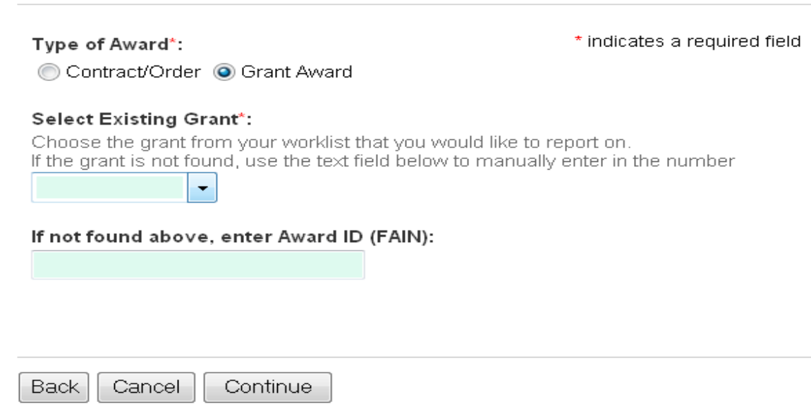
FSRS – Federal Funding Reporting System

Slide 82
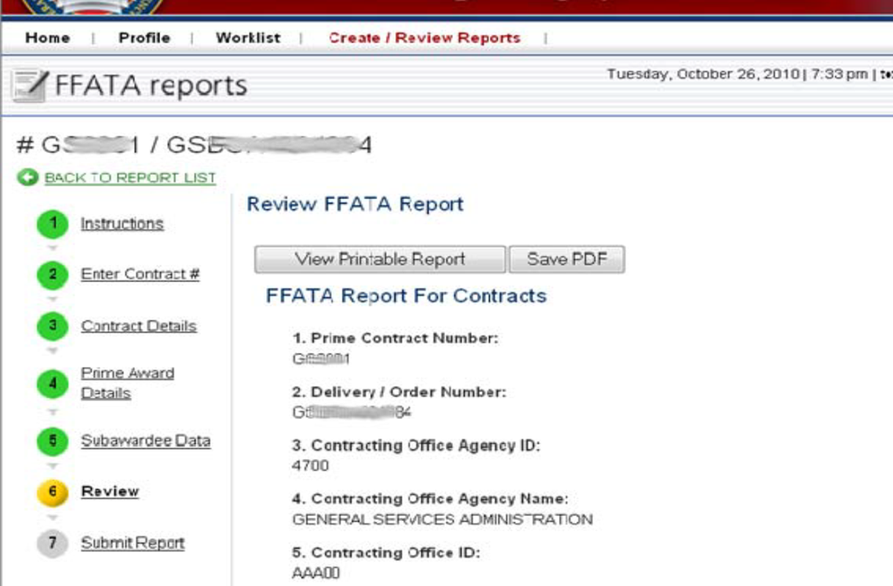

FSRS – Federal Funding Reporting System

Slide 83
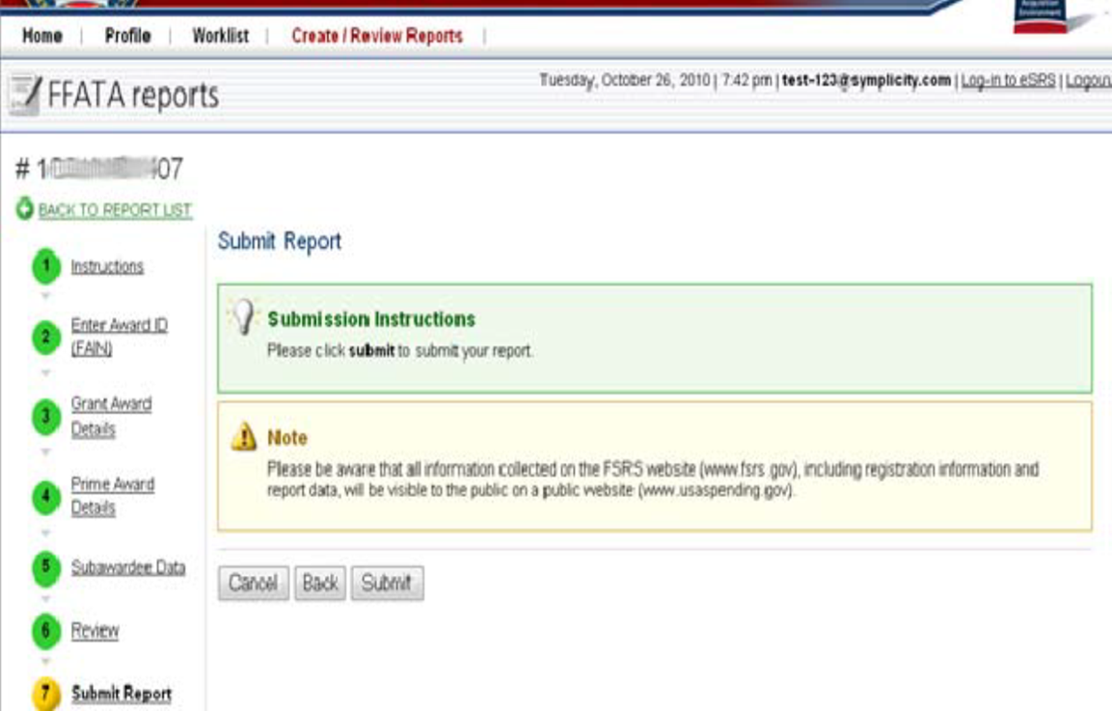


FSRS – Federal Funding Reporting System

Slide 84

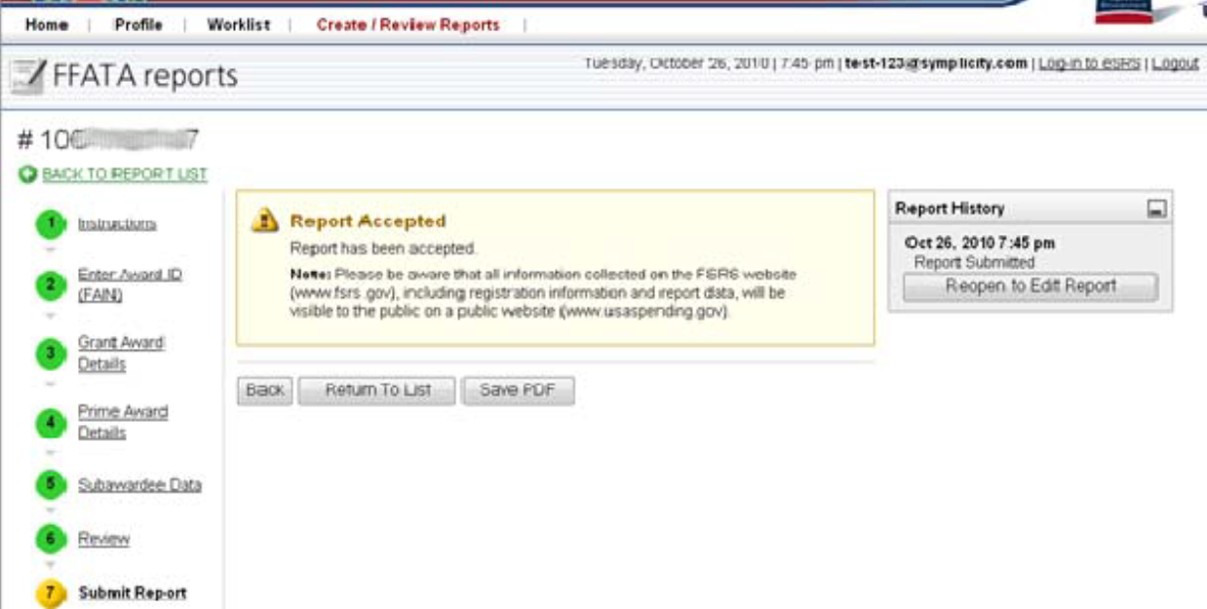
FSRS – Federal Funding Reporting System

Slide 85


U.S. Department of Justice

Slide 86
Break Out Sessions
Break Out Sessions – Place holder

Slide 87
BREAK TIME

Slide 88
15 Minutes
Notes:
88
88
Using this PowerPoint break timer
This PowerPoint slide uses images, custom animation, and timing to provide a countdown timer that you can use in any presentation. When you open the template, you’ll notice that the timer is set at 00:00. However, when you start the slide show, the timer will start at the correct time and count down by 1-minute intervals until it gets to 1 minute. At that point, it will count down in two 30-seconds intervals to 00:00.
To insert this slide into your presentation
Save this template as a presentation (.ppt file) on your computer.
Open the presentation that will contain the timer.
On the Slides tab, place your insertion point after the slide that will precede the timer. (Make sure you don't select a slide. Your insertion point should be between the slides.)
On the Insert menu, click Slides from Files.
In the Slide Finder dialog box, click the Find Presentation tab.
Click Browse, locate and select the timer presentation, and then click Open.
In the Slides from Files dialog box, select the timer slide.
Select the Keep source formatting check box. If you do not select this check box, the copied slide will inherit the design of the slide that precedes it in the presentation.
Click Insert.
Click Close.

Slide 89
Monitoring Discussion

Slide 90

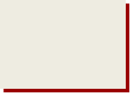
Grants Financial Management Division’s Mission
To ensure stewardship over Federal funds
awarded by:
Conducting On-Site Financial Reviews
Conducting OCFO-Desk Based Financial Reviews
Providing Technical Assistance to Grantees

Slide 91

Monitoring Discussion
How are grants selected for on site review?
Grantee’s Request for Technical Assistance
Random Sample
Risk Assessment
New Grant or
Grantee
Problems Identified from OCFO Desk Review
Dollar Amount of
Award
Program Office Request

Slide 92
Monitoring Discussion
What will be reviewed during the on-site visit?
Internal Controls
Accounting System
Accounting procedures including cash management procedures
Federal Financial Reports (SF-425s)
Test and Analyze expenditures
Provide technical assistance

Slide 93
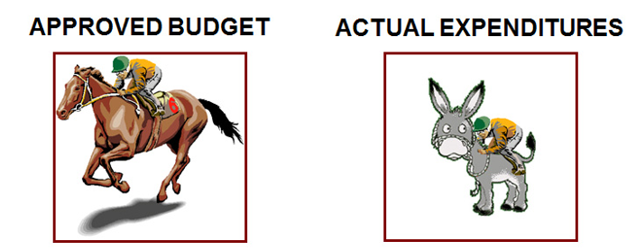
Monitoring Discussion
Compare your actual expenditures with your grant objectives and approved budget
Are you spending the money according to the purpose of the award?

Slide 94
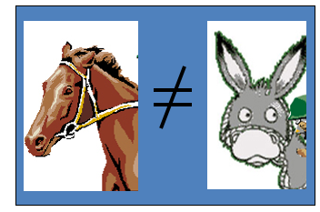
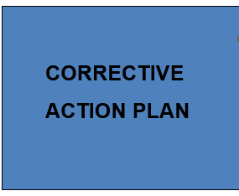

Monitoring Discussion
Compare your actual expenditures with your grant objectives and approved budget
OCFO will help you get back on track

Slide 95
Monitoring Discussion
What are the objectives of the OCFO based desk review?
Conduct an analysis of grant activity to date
Analyze Federal Financial Reports (SF-425s)
Determine compliance with audit report submission requirements
Evaluate payments -- determine excess cash
Identify grantees who need on-site financial review

Slide 96
Monitoring Discussion
Primary Grantee’s Responsibility
The primary grant recipient is responsible for monitoring the subrecipient and ascertaining that all fiscal and programmatic responsibilities are fulfilled, including compliance with Federal rules and regulations (e.g., 2 CFR Part 200, EEO compliance).

Slide 97
Top 10 Monitoring Findings (FY 2024)
Procedures not documented or need improvement
1
2
Internal Control Weakness – Procedures not followed
FFRs do not reconcile with grantee’s accounting records
3
4
FFATA reporting requirements not met

Slide 98
Top 10 Monitoring Findings (FY 2024)
5
All Grant Administrators and Financial Managers should take the DOJ online training course
Inadequate Subrecipient Files/Documentation
6
Subrecipient Files/Documentation
7
Unsupported Costs - Personnel
8

Slide 99
Top 10 Monitoring Findings (FY 2024)
9
Single Audit Report delinquent
Non-compliance with Award Special Condition – Unauthorized Expenditures/Drawdowns
10

Slide 100
Closeout
For The OIG Grant Fraud slides-
Please refer to the zip file you received by email.

Slide 101
Closeout

Slide 102
Closeout
Cash Reconciliation and Final Drawdown
Award recipients must conduct a financial reconciliation of their accounting records to the final Federal Financial Report (FFR/SF-425) at closeout. Recipients must:
Report final Federal share of cumulative expenditures and recipient share, if required, on the final FFR.
Liquidate obligations incurred prior to end of the period of performance no more than 120 days after the project period end date.
Request final draw down of Federal expenditures made within the approved period of performance in conjunction with the final SF-425. This request must be submitted prior to the end of the liquidation period.
Funds will be frozen after 120 days.

Slide 103

Closeout
Closeout Requirements
Within 120 days of the end of the award period, the recipient must submit the following:
Final Federal Financial Report
Final Performance Report
Refund of Excess Cash
Funds will be frozen after 120 days.

Slide 104
Closeout
Refund Excess Cash
Make check payable to DOJ/Office of Justice Programs
Cover letter or voucher containing the grant number for the refund, itemization of funds and the unobligated balance
Printout of the final SF-425 report which supports the amount of the refund
Failure to remit payment to OJP will be referred to the U.S. Department of the Treasury for collection.
Funds will be frozen after 120 days.

Slide 105

U.S. Department of Justice
Home Stretch

Slide 106
Resources

Slide 107

Resources
General Information
Pre-award Requirements
Post Award Requirements
Organization Structure
Appendices
DOJ Grants Financial Guide 2022 | Welcome to the DOJ Grants Financial Guide | Office of Justice Programs (ojp.gov)

Slide 108
Resources
OCFO Financial Questions via Telephone/Internet
OCFO Customer Service Center
Monday through Friday
8:30 a.m. - 6:00 p.m. est.
1-(800) 458-0786 or (202) 305-9988
FAX (202) 353-9279
OCFO e-mail Address:
ask.ocfo@usdoj.gov

Slide 109

Resources
eCFR :: 2 CFR Part 200 -- Uniform Administrative Requirements, Cost Principles, and Audit Requirements for Federal Awards

Slide 110

Resources
How to Access Grant $$
Assistance Listings (formerly Catalogue of Federal Domestic Assistance CFDA)
Over 2,500 Programs
Available at www.sam.gov

Slide 111

Resources
In The End…
Some Things to Remember!
Get through the Maze!

Slide 112
Memorable Moments
Dates:
  Award
  Obligation
  Expenditure
  Budget modifications, no cost extensions & other GANs
  Drawdown
  Reporting (Financial & Performance)
  Documentation!

Slide 113




Wrap Up
Last thoughts
Evaluations
Certifications
Thanks for coming!

Slide 114

The End

